Slide 1
Strategic Enrollment Management
Faculty Senate Meeting
January 28, 2020
Tomikia P. LeGrande, Ed.D.
Vice Provost for Strategic Enrollment Management

Slide 2
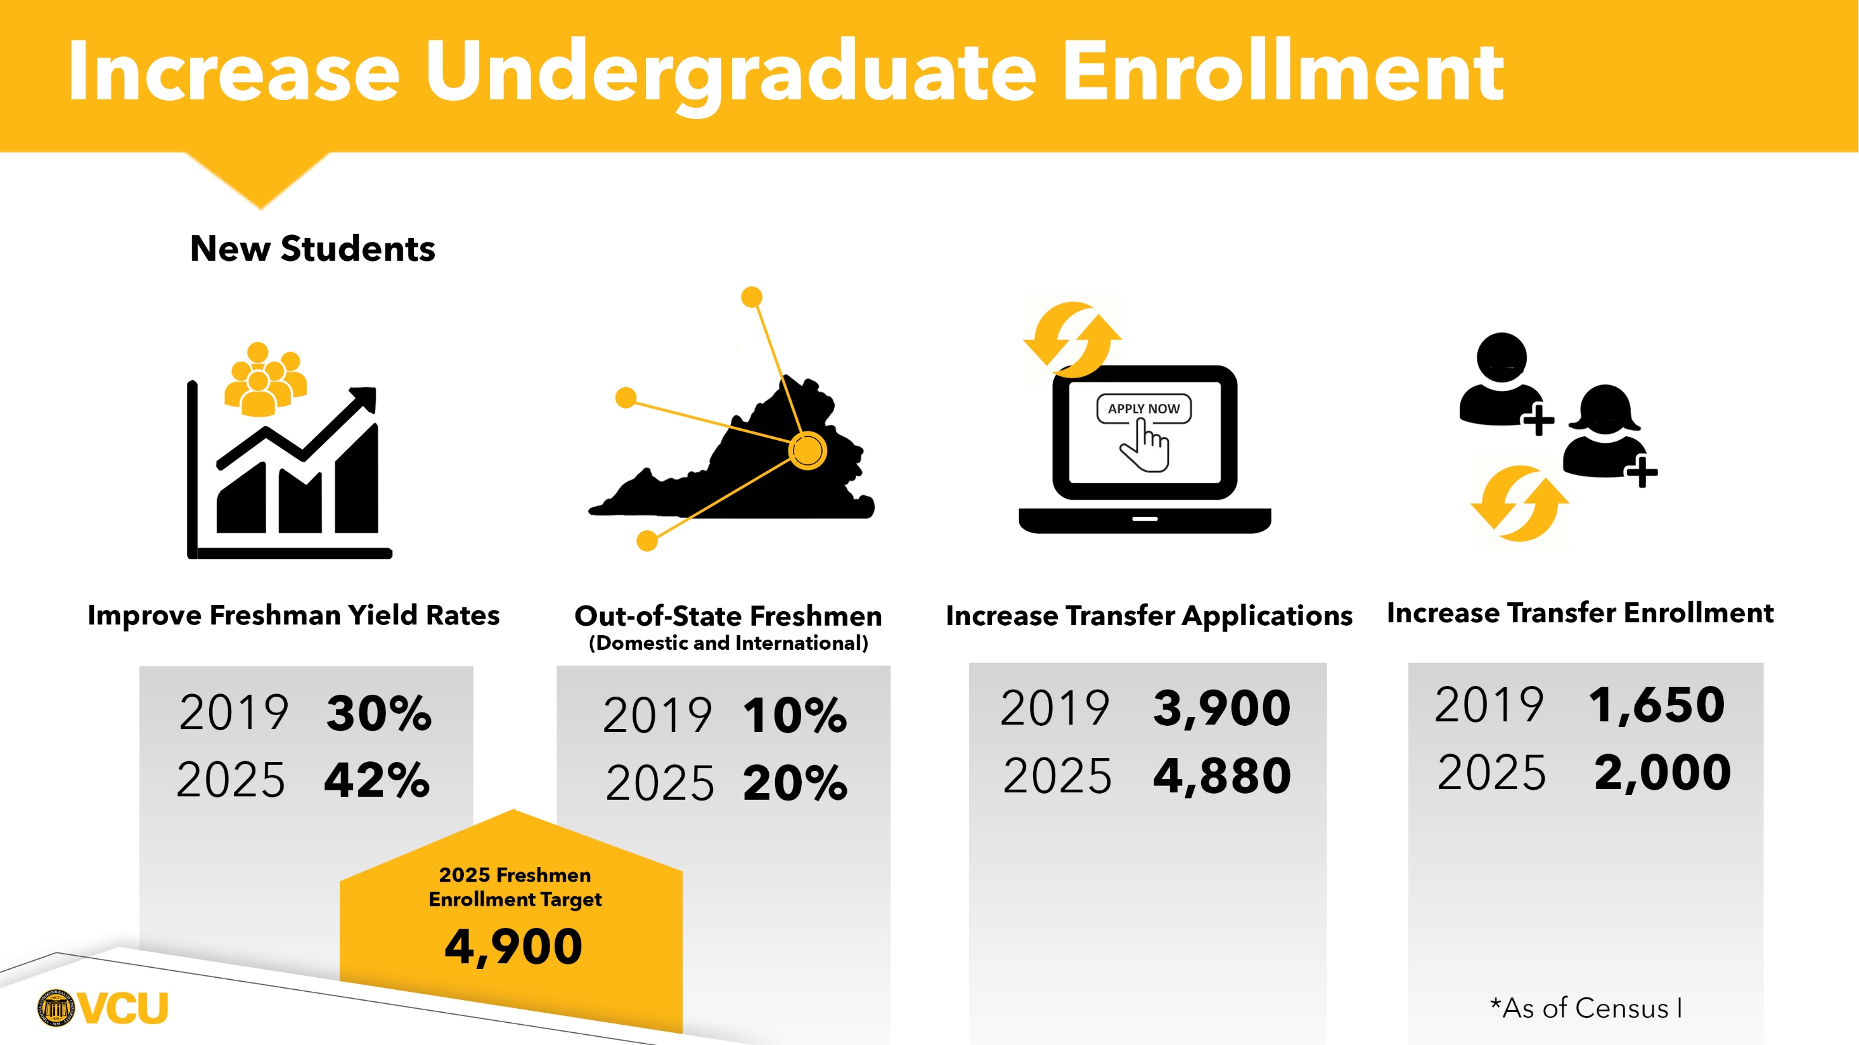

Slide 3
VCU freshman acceptance trends highlight increasing awareness and interest in the VCU brand; however, enrollment yield identifies increasing in-state competition.

Slide 4
VCU transfer trends are consistent with a shrinking population of community college students. Future growth in this population will require expanding to a broader target market of transfer students.

Slide 5
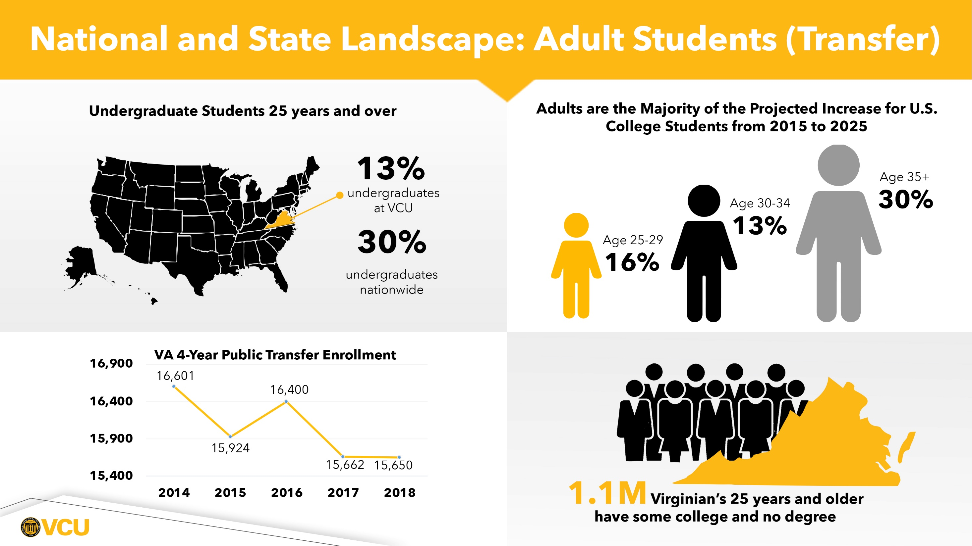

Slide 6
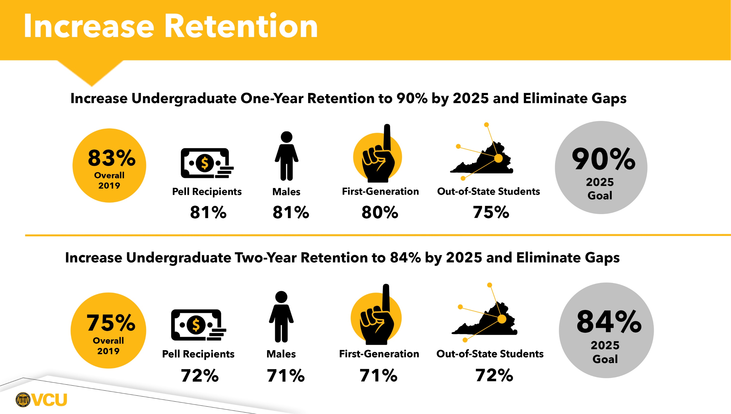

Slide 7
VCU Student Success
Achievement of VCU Student Success Goals requires addressing the needs of vulnerable student populations:
  Low-Income Students
  First-Generation Students
  Out of State Students
Advancing educational equity to help those finish what they started
  College Stop-Outs
Create a Culture of Care: Connect and Complete

Slide 8
Course Scheduling Redesign
To optimize VCUs course offerings, space utilization, and faculty resources to positively impact timely progress to degree for undergraduate students.
  Policy and practice that creates:
    Collaboration among units in Scheduling
    Standardization of scheduling
    Responsive processes that analyze and manage Course/Space Availability
    Efficient use of technology systems:
      Utilize existing functionality in Banner student information system
      Implement Astra Schedule
To develop multi-year course offering schedules to allow for greater transparency for students and advisors.
To utilize degree progress data to inform course offerings.
Scheduling Infrastructure
Data Informed Scheduling
Instructional Space Management

Slide 9
Course Scheduling Project Organization
Creation of Course Scheduling Redesign Councils
  Course Scheduling Redesign Leadership Council
  Course Scheduling Redesign Operations Council
    Scheduling Grid
    Course Scheduling
    Space Assignment
    Course Enrollment Management
Project Implementation in Phases
  Pilot with several Schools/Colleges – Fall 2020 Course Schedule
    Creating more efficiency in course scheduling:
      Utilizing recommended existing functionality in Banner
      Reengineering the business process
  Feedback sessions on proposed recommendations
    Scheduling Grid
    Course Scheduling
    Space Assignment
    Course Enrollment Management
  All School and Colleges – Fall 2021 Course Schedule

Slide 10
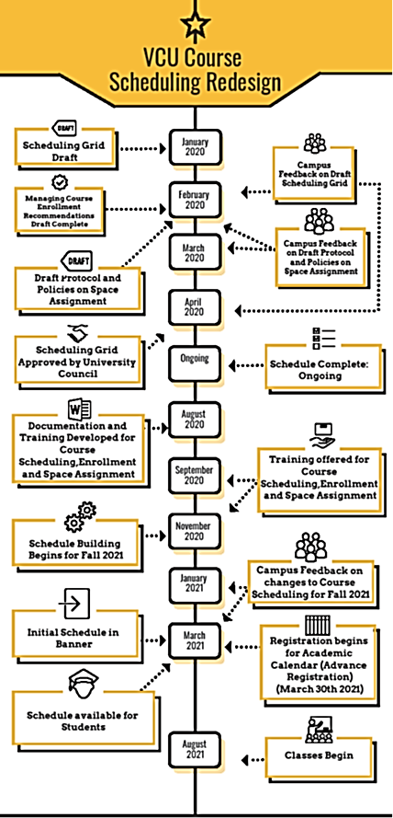

Slide 11
Implementation of Student Financial Services
Staffing Model
Policy & Practice
Use of Technology and Data
Net Price Calculator
Navigate for nudges related to financial matters
Online Check-in & Queuing System
Chatbot
Create Student Financial Management Center
Role of Financial Counselor
  Financial outreach, literacy, proactive case management counseling
  Serve as a single point of contact.
  Blend of permanent FTE (13), graduate and undergraduate peer counselors.
Reengineer processes, communications, compliance and responsiveness
Tuition and Fee Simplification

Slide 12
Reminder of SEM Priorities
Continued focus on improved national brand perception, academic reputation and VCU value proposition
Focus on improved new undergraduate student yield rates
Expand and identify new undergraduate markets
  Out of State Undergraduates
  Adults over age 24
  Corporate partnerships
Support of continued innovation in curriculum and retention efforts
  Course Scheduling Redesign
  Student Financial Services

Slide 13
Open Discussion

